Slide 1
Usability Engineering Basics
Prof. Dr. Christian Reimann

Slide 2
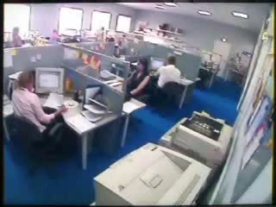
Using a PC? Problem?

Slide 3
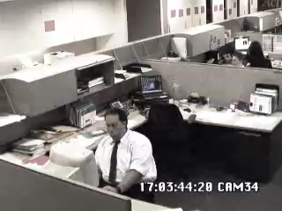
Stress?

Slide 4
Definition „Usability“
Usability is defined by the
Effectiveness,
Efficiency and
Joy
with which users can achieve a goal, or accomplish a task.
How to ensure good usability?
In a structured process, so it is
Reliable,
Repeatable,
Etc.
But not plain luck ;-)
User Centered Design Process (ISO 9241-210)
generally accepted process (at least as basis) for sw-development

Slide 5
Human Perception
Highly optimised, for hunters and gatherers
Large amount of interpretation done by our brain
Edge detection
Shape detection
Can lead to errors in HCI

Slide 8
(Very simplified version of) Human Memory
Sensor memory
Short term memory
Long term memory

Slide 9

Sensor Memory

Slide 10
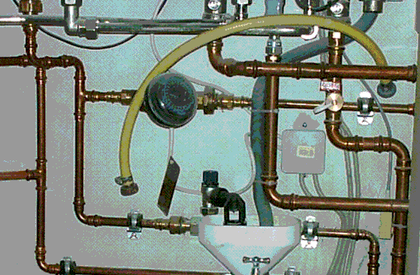
Sensor Memory

Slide 11
Short term memory
Defines our scope of attention
Attention can not be devided
Capacity typically 7 +-2

Slide 12
Long term memory
Declarative memory
Production memory
Implicit vs. Explicit knowledge
All our gathered knowledge and experience form our inner landscape
Mental models
Are ALWAYS generated
Recursive: build on existing models

Slide 13
How we act...
Intellectual level
conscious action
Flexible patterns
semi automated action
Sensomotor level
„Full auto mode“

Slide 14
Response times
Depend on application and context
Rule of thumb:
< 1 sec: instantanious
< 5 sec: delayed
< 10 sec: extremely delayed
> 10 sec: no response expected

Slide 15
Communication

Slide 16
Levels of communication
Pragmatic level
Semantic level
Syntactic level
Mistakes can happen on every level
Examples? Results?

Slide 17
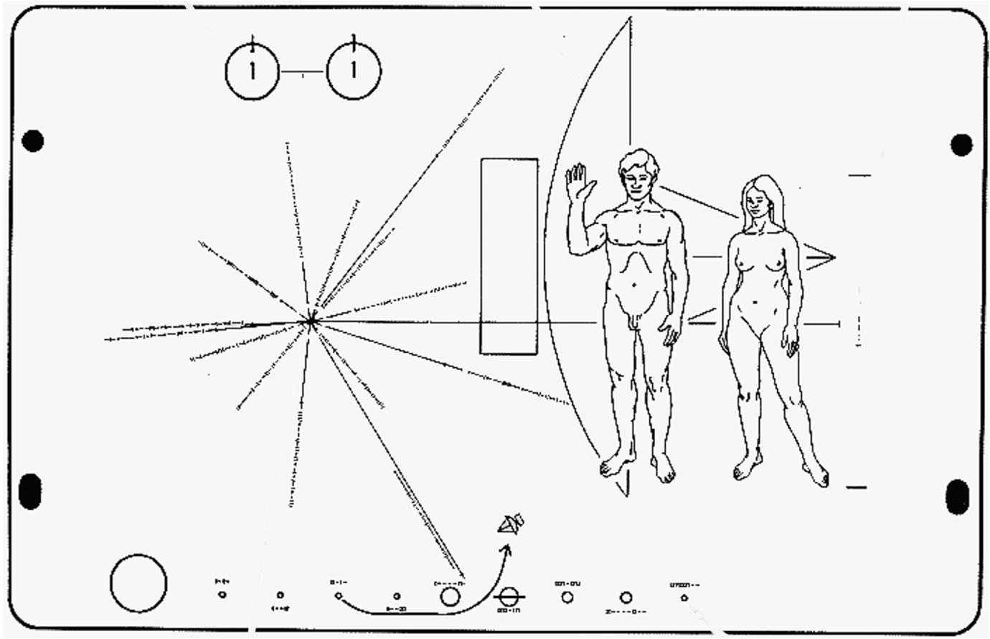
Universal?

